Slide 1

School of Computing Science and Engineering
School of Computing Science and Engineering
Program Name: BTech , 5 SEM
Course Code : E2UC502T
Course Name : Software Testing & Quality Assurance
Module 1
Dr. Azath Hussain M.E., PhD.

Slide 2
School of Computing Science and Engineering
“Software Metrics"
Software Metrics
A software metric is a measure of software characteristics which are measurable or countable.
Software metrics are valuable for many reasons, including measuring software performance, planning work items, measuring productivity, and many other uses.
Within the software development process, many metrics are that are all connected. Software metrics are similar to the four functions of management: Planning, Organization, Control, or Improvement.

Slide 3
School of Computing Science and Engineering
“Software Metrics"
Classification of Software Metrics
Software metrics can be classified into two types as follows:
Product Metrics: These are the measures of various characteristics of the software product. The two important software characteristics are:
Size and complexity of software.
Quality and reliability of software.
Henry and Kafura Metric:
Information Flow metrics deal with this type of complexity by observing the flow of information among system components or modules. This metrics is given by Henry and Kafura. So it is also known as Henry and Kafura's Metric.
A Global flow exists from procedure A to Procedure B if A deposits information into a global variable and B retrieves information from the variable.

Slide 4
School of Computing Science and Engineering
“Software Metrics"
Classification of Software Metrics
Software metrics can be classified into two types as follows:
Process Metrics: These are the measures of various characteristics of the software development process. For example, the efficiency of fault detection. They are used to measure the characteristics of methods, techniques, and tools that are used for developing software.

Slide 5
School of Computing Science and Engineering
“Software Metrics"
Figure 1: Classification of Software Metrics

Slide 6
School of Computing Science and Engineering
“Software Metrics"
Types of Metrics
Internal metrics: Internal metrics are the metrics used for measuring properties that are viewed to be of greater importance to a software developer. For example, Lines of Code (LOC) measure.
External metrics: External metrics are the metrics used for measuring properties that are viewed to be of greater importance to the user, e.g., portability, reliability, functionality, usability, etc.
Hybrid metrics: Hybrid metrics are the metrics that combine product, process, and resource metrics. For example, cost per FP where FP stands for Function Point Metric.

Slide 7
School of Computing Science and Engineering
“Software Metrics"
Types of Metrics
Project metrics: Project metrics are the metrics used by the project manager to check the project's progress.
Data from the past projects are used to collect various metrics, like time and cost; these estimates are used as a base of new software.
Note that as the project proceeds, the project manager will check its progress from time-to-time and will compare the effort, cost and time with the original effort, cost and time. Also understand that these metrics are used to decrease the development costs, time efforts and risks.
The project quality can also be improved. As quality improves, the number of errors and time, as well as cost required, is also reduced.

Slide 8
School of Computing Science and Engineering
“Software Metrics"
Advantage of Software Metrics
Comparative study of various design methodology of software systems.
For analysis, comparison, and critical study of different programming language concerning their characteristics.
In comparing and evaluating the capabilities and productivity of people involved in software development.
In the preparation of software quality specifications.
In the verification of compliance of software systems requirements and specifications.
In making inference about the effort to be put in the design and development of the software systems.

Slide 9
School of Computing Science and Engineering
“Software Metrics"
Advantage of Software Metrics
In getting an idea about the complexity of the code.
In taking decisions regarding further division of a complex module is to be one or not.
In guiding resource manager for their proper utilization.
In comparison and making design tradeoffs between software development and maintenance cost.
In providing feedback to software managers about the progress and quality during various phases of the software development life cycle.
In the allocation of testing resources for testing the code.

Slide 10
School of Computing Science and Engineering
“Software Metrics"
Disadvantages of Software Metrics
The application of software metrics is not always easy, and in some cases, it is difficult and costly.
The verification and justification of software metrics are based on historical/empirical data whose validity is difficult to verify.
These are useful for managing software products but not for evaluating the performance of the technical staff.
The definition and derivation of Software metrics are usually based on assuming which are not standardized and may depend upon tools available and working environment.

Slide 11
School of Computing Science and Engineering
“Software Metrics"
Size Oriented Metrics
LOC Metrics
It is one of the earliest and simpler metrics for calculating the size of the computer program. It is generally used in calculating and comparing the productivity of programmers.
These metrics are derived by normalizing the quality and productivity measures by considering the size of the product as a metric.

Slide 12
School of Computing Science and Engineering
“Software Metrics"
Following are the points regarding LOC measures:
In size-oriented metrics, LOC is considered to be the normalization value.
It is an older method that was developed when FORTRAN and COBOL programming were very popular.
Productivity is defined as KLOC / EFFORT, where effort is measured in person months.
Size-oriented metrics depend on the programming language used.
As productivity depends on KLOC (thousands of Lines of Code), so assembly language code will have more productivity.
LOC measure requires a level of detail which may not be practically achievable.
The more expressive is the programming language, the lower is the productivity.
LOC method of measurement does not apply to projects that deal with visual (GUI based) programming. As already explained, Graphical User Interfaces (GUIs) use forms basically. LOC metric is not applicable here.

Slide 13
School of Computing Science and Engineering
“Software Metrics"
Following are the points regarding LOC measures:
It requires that all organizations must use the same method for counting LOC. This is so because some organizations use only executable statements, some useful comments, and some do not. Thus, the standard needs to be established.
These metrics are not universally accepted.

Slide 14
School of Computing Science and Engineering
“Software Metrics"
Functional Point (FP) Analysis
Allan J. Albrecht initially developed function Point Analysis in 1979 at IBM and it has been further modified by the International Function Point Users Group (IFPUG). FPA is used to make estimate of the software project, including its testing in terms of functionality or function size of the software product. However, functional point analysis may be used for the test estimation of the product. The functional size of the product is measured in terms of the function point, which is a standard of measurement to measure the software application.
Objectives of FPA
The basic and primary purpose of the functional point analysis is to measure and provide the software application functional size to the client, customer, and the stakeholder on their request. Further, it is used to measure the software project development along with its maintenance, consistently throughout the project irrespective of the tools and the technologies.

Slide 15
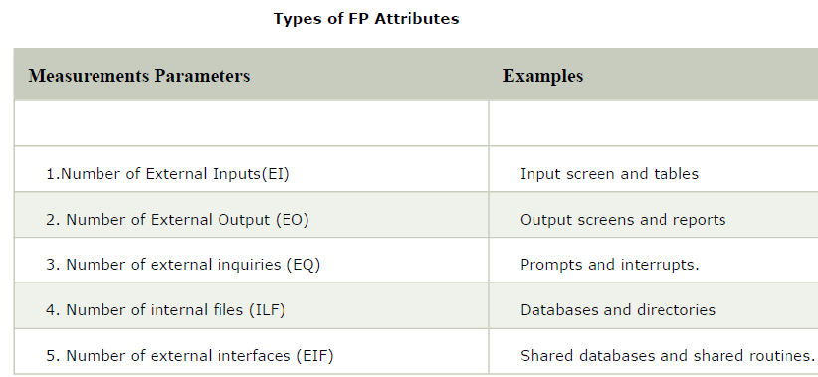
School of Computing Science and Engineering
“Software Metrics"
Following are the points regarding FPs
FPs of an application is found out by counting the number and types of functions used in the applications. Various functions used in an application can be put under five types, as shown in Table:

Slide 16
School of Computing Science and Engineering
“Software Metrics"
All these parameters are then individually assessed for complexity. The FPA functional units are shown in Fig:

Slide 17
School of Computing Science and Engineering
“Software Metrics"
FP characterizes the complexity of the software system and hence can be used to depict the project time and the manpower requirement.
The effort required to develop the project depends on what the software does.
FP is programming language independent.
FP method is used for data processing systems, business systems like information systems.
The five parameters mentioned above are also known as information domain characteristics.

Slide 18
School of Computing Science and Engineering
“Bottom Up and Town Down Model "
Top-Down Design Model:
In the top-down model, an overview of the system is formulated without going into detail for any part of it. Each part of it then refined into more details, defining it in yet more details until the entire specification is detailed enough to validate the model. if we glance at a haul as a full, it’s going to appear not possible as a result of it’s so complicated.
For example: Writing a University system program, writing a word processor. Complicated issues may be resolved victimization high down style, conjointly referred to as Stepwise refinement where,
We break the problem into parts
Then break the parts into parts soon and now each of parts will be easy to do.

Slide 19
School of Computing Science and Engineering
“Bottom Up and Town Down Model "
Advantages:
Breaking problems into parts help us to identify what needs to be done.
At each step of refinement, new parts will become less complex and therefore easier to solve.
Parts of the solution may turn out to be reusable.
Breaking problems into parts allows more than one person to solve the problem.

Slide 20
School of Computing Science and Engineering
“Bottom Up and Town Down Model "
Bottom-Up Design Model:
In this design, individual parts of the system are specified in detail.
The parts are linked to form larger components, which are in turn linked until a complete system is formed. Object-oriented language such as C++ or java uses a bottom-up approach where each object is identified first.
Advantages
Make decisions about reusable low-level utilities then decide how there will be put together to create high-level construct.

